Slide 1
Busting The “Princelings”: The Campaign Against Corruption in China’s Primary Land Market
Ting Chen, James Kai-sing Kung The Quarterly Journal of Economics, Volume 134, Issue 1, February 2019, Pages 185–226
Reported By Wang Yi

Slide 2
I.
Introduction
II.
Background
III.
Data Construction
CONTENTS
IV.
Price Discount Obtained By Princeling Firms
V.
Effect Of Business Favor On Promotion
VI.
Effect Of Xi’s Anticorruption Campaign
VII.
Conclusion

Slide 3
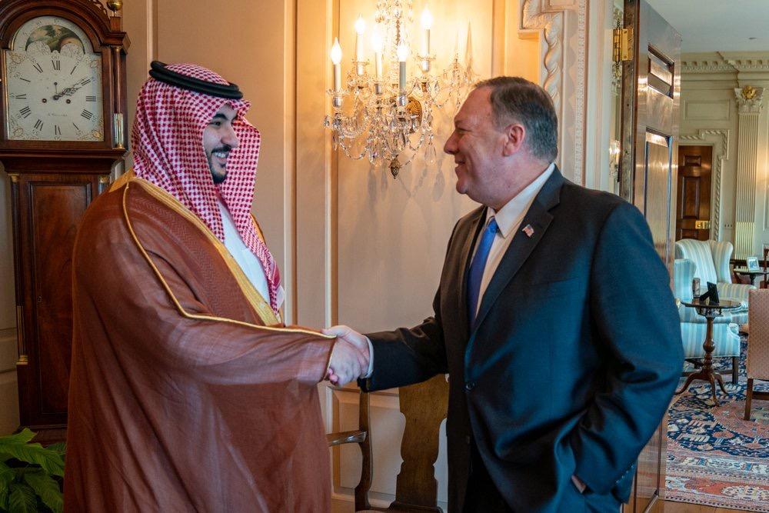
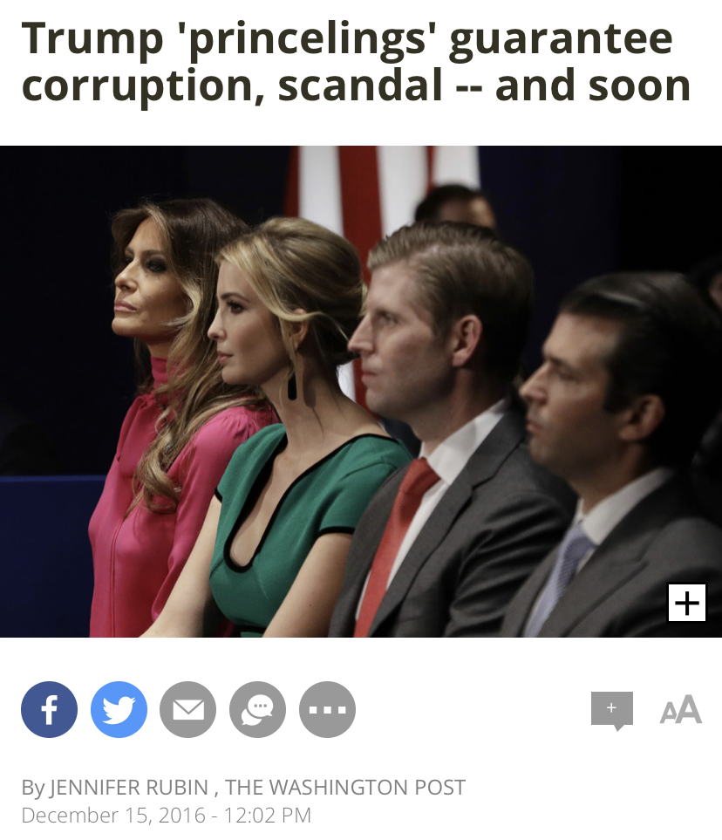

I. Introduction
Rampant cronyism —— Wealthy princelings

Slide 4
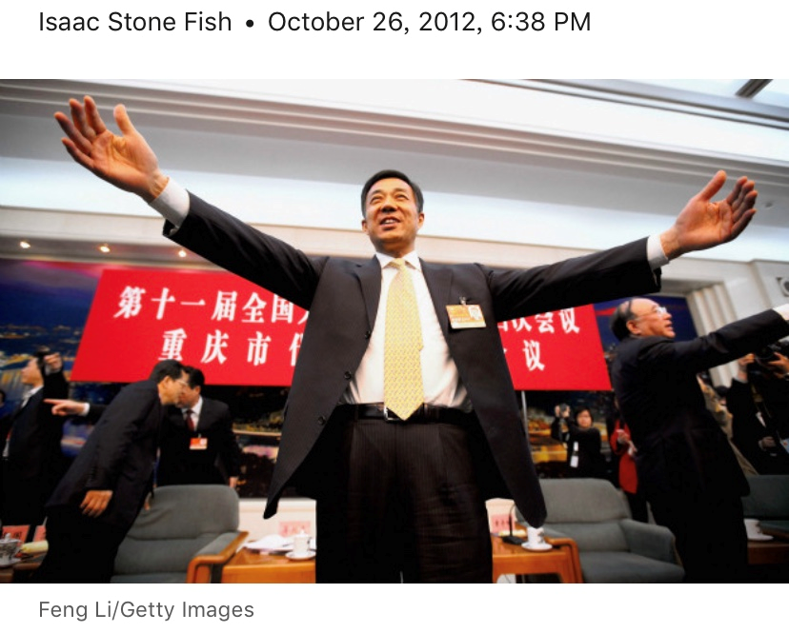
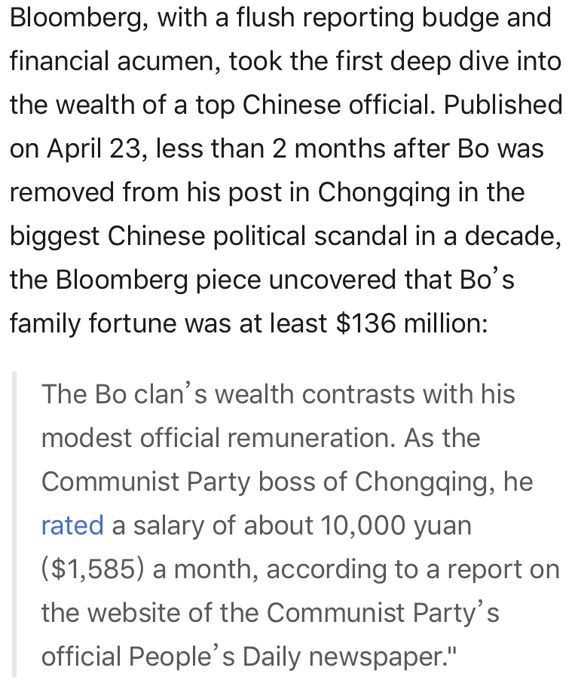
I. Introduction
An Example——Disproportionate power
Bloomberg: Bo Xilai Clan links Included Citigroup Hiring of Elder Son

Slide 5
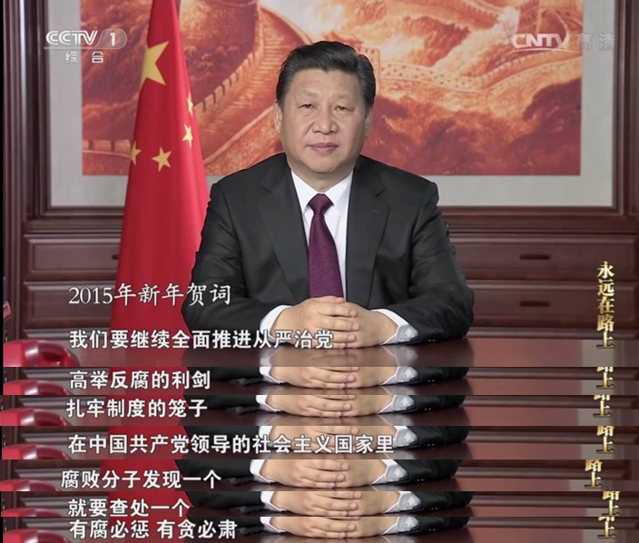
II. Background
II.A. Xi’s Anticorruption Campaign
Xi strengthened the CCDI——To strengthen the political independence of local operations
Replace provincial officials
Recognized the land market as a major target
More intense and long-lasting

Slide 6
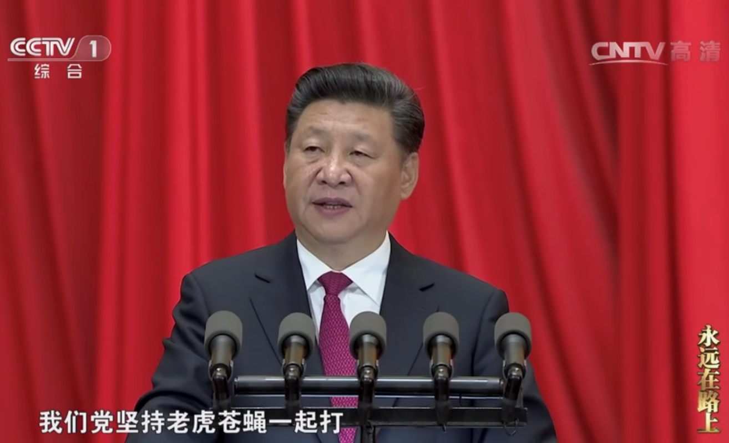
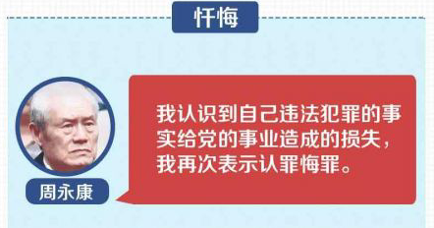
II. Background
II.A. Xi’s Anticorruption Campaign
The biggest breakthrough
Brought down Zhou Yongkang, Ling Jihua —— Two of the most powerful political figures
Send a strong message to the princelings——No tolerate corruption！

Slide 7
II. Background
II.B. Cronyism in China: A Conceptual Framework
How cronyism works in China？
Why does cronyism work like this in China？
——Two institutional features
Pecuniary Benefits
Politburo Standing Committee
(connections)
Scarce, Government-Owned Resources
Price Discount
Local Officials
Princeling Firms
(connections)
Politburo
Promotion Prospects
The Decentralization of Control Rights
e.g. de jure ownership over land to local governments
The “One-Level-Up” Policy
e.g. the promotion of the province-level officials—especially the province party secretaries

Slide 8
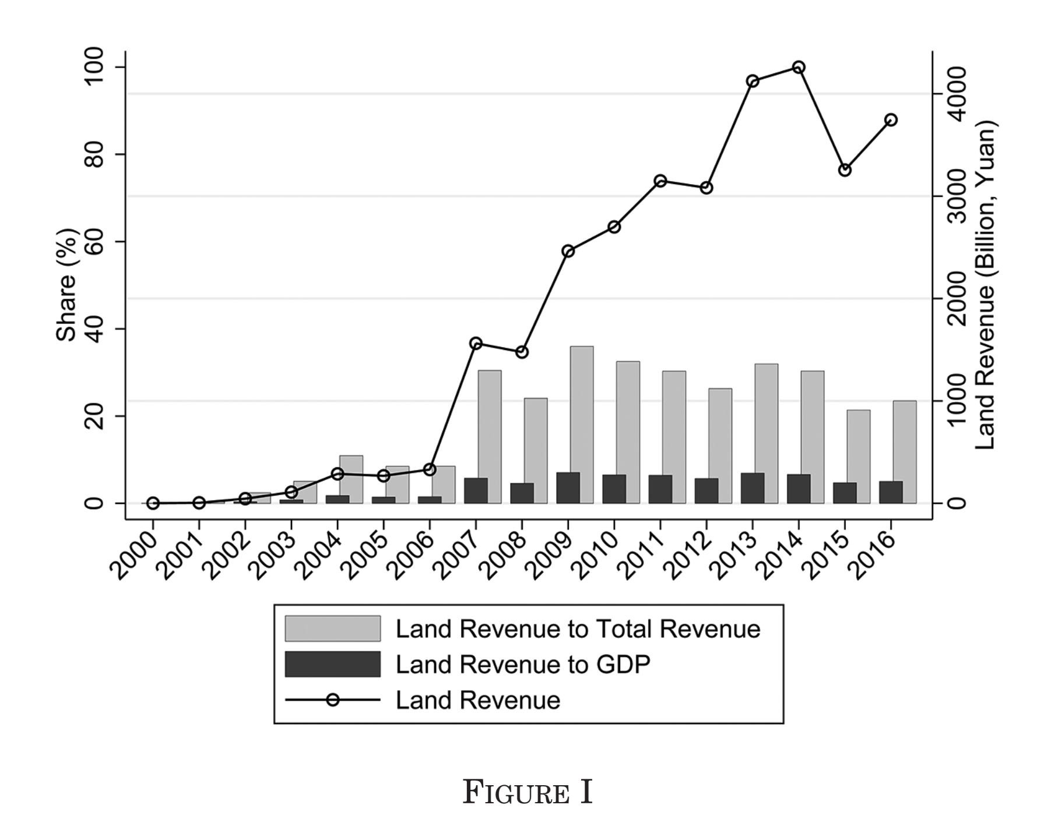
II. Background
II.C. Corruption in China’s Primary Land Market
Why it is ideal for examining the trading of favors between the princeling firms and local officials？
Local Governments —— the sole statutory owner and supplier of land
Land Finance Revenue—— the main tax revenue of local government
Nearly a quarter (23%) of the 2,802 corruption cases are related to
The primary land market.
(Jiancha Ribao ,2000 ~ 2009)
The real estate sector —— A “hotbed of crony capitalism in China”

Slide 9
II. Background
II.D. The Mainline of the Literature
How much the corrupt deals benefit each side？
The impact of President Xi’s anti-corruption campaign？
Main Conclusions of the Literature
Princeling Firms —— a price discount ( 55.4% ~ 59.9% )，More land purchases
Provincial Party Secretaries —— 23.4% more likely to be promoted
a reduction in corruption —— between 42.6% and 31.5% in the provinces
a reduction in the promotional prospects

Slide 10
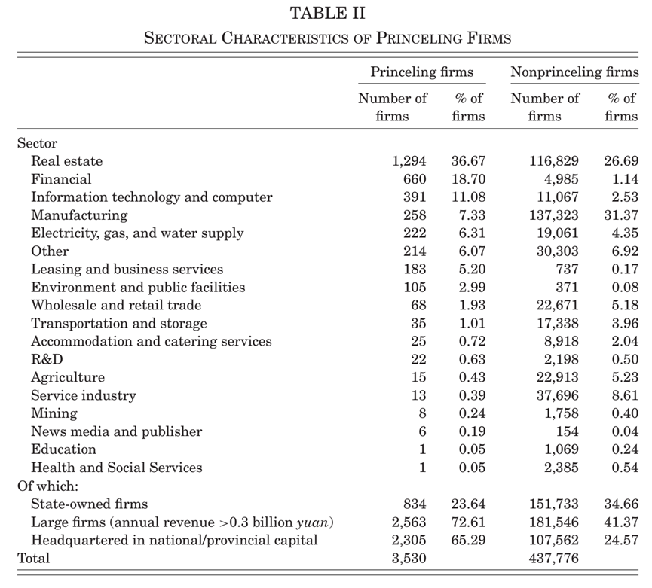
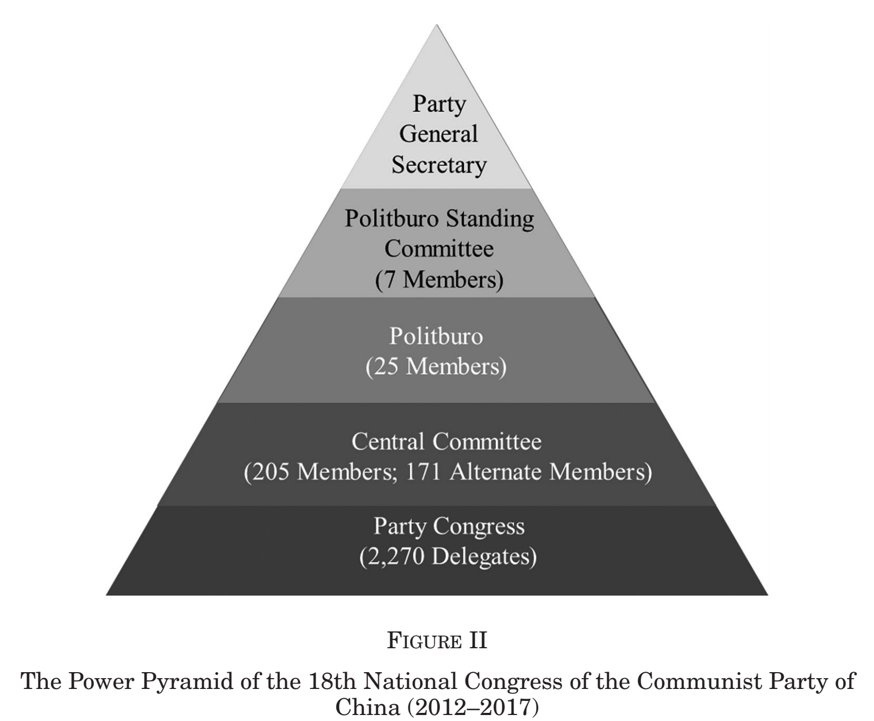
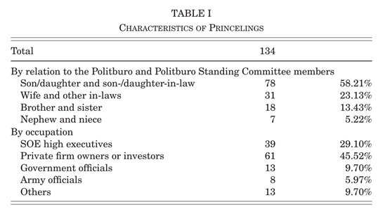
III. Data Construction
III.A. Firms Connected to the Princelings
Definition Princelings
Identifying Princelings
Identifying Firms Connected
to the Princelings
Ownership
Size
Sample —— 64 Politburo members
spanning four National Congresses(15th ~18th)
Headquartered in National/Povincial Capital
primarily children and family members of the elite party members who served between 1997 and 2016
36 members+28 Standing Committee member
134 Princelings
Sectoral Distribution
the primary land market is an area
where rents are up for grabs
From multiple sources:
Bloomberg,
New York Times,
Washington Post,
The Guardian ,
China Digital Times ,
And ICIJ .etc.
48
Politburo members
2/3
0.81%

Slide 11
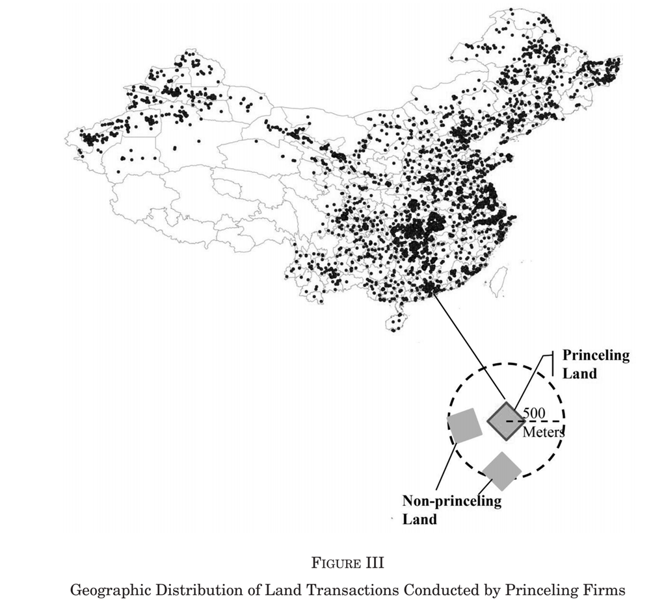
III. Data Construction
III.B. Matching Land Transactions with the Princeling Firms
To estimate the price discount —— A Data Set (the website of the LandTransaction Monitoring System)
All land transactions in China’s primary land market (2004 ~ 2016)
1,151,358 land transactions(>70%) purchased by firms
The details of each transaction { size，location，total payment，date，names of seller and buyer, specific method of transaction，a two-digit code of land usage，land parcel quality (as subjectively evaluated by
the official-in-charge on a 20-point scale )，a three-digit industry code of the buyer’s firm }
Match —— 19,812 land parcels were purchased by the princeling firms during the period.

Slide 12
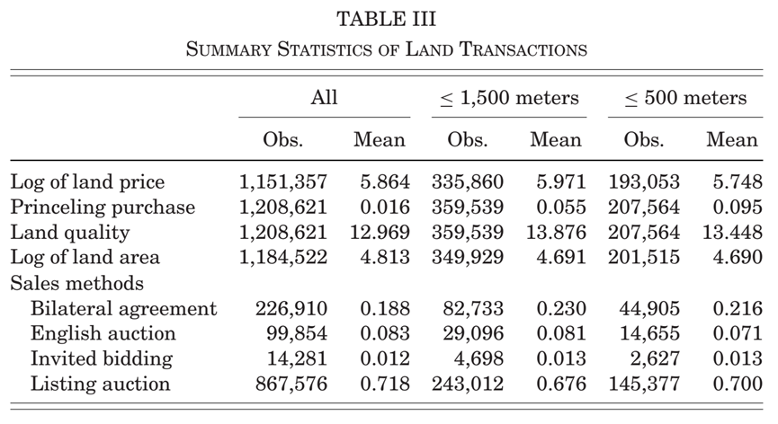

III. Data Construction
III.C. A Spatially Matched Sample for Identification
Randomized Controlled Trial (RCT)
Princeling Firms
(treatment group)
Price Difference Preferential Treatment
Nonprinceling Firms
(control group)
Selection Bias = 0
(the princeling firms may selectively purchase land of higher quality or market value)
Spatial Matching Approach
Generating a sample of land transactions of Nonprinceling firms
(in the same year and within the same distances) within a 500-meter radius (3 blocks) —— 207,564 land parcels
within a 1500-meter radius(8 blocks) —— 359,539 land parcels

Slide 13
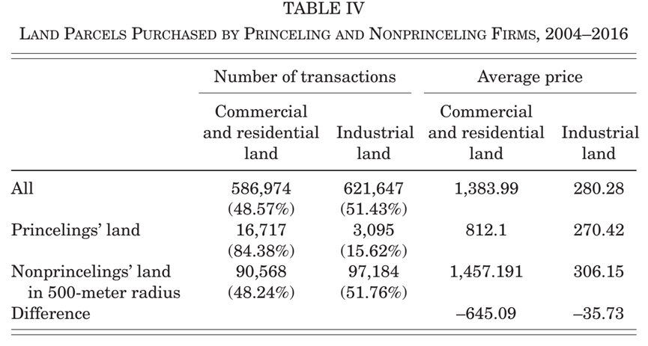
IV. Price Discount Obtained By Princeling Firms
Begin With A Simple Comparison
Average price : 5 times
Princeling firms : mostly purchased
the former
Hardly a fair comparison :
1384-812=572(41% )
Compare like with like :
1457-812=645(44% )
Princeling firms : the discount mostly comes from the former
(44% VS12% )

Slide 14
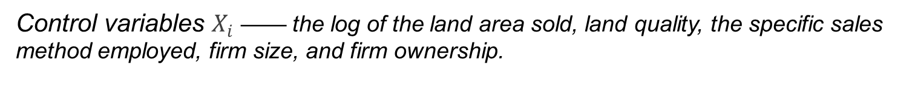
IV. Price Discount Obtained By Princeling Firms
Regression Model —— OLS(Pooled Regression —— Short Panel)
$${Price}_{ickst}=β_{0}+β_{1}{PrincelingPurchase}_{ikjt}+γX_{i}+T_{cst}+v_{ickst}.$$
${\text{D}\text{ependent} \text{variable} Price}_{ickst}$—— the log of price (yuan per square meter)
for land parcel $i$sold by municipal government $c$to $\text{firm} k$for usage $s$in month-year $t.$
The key explanatory variable ${PrincelingPurchase}_{ikjt}$ —— Dummy variable
equal to 1 if a firm $k$ is connected to a princeling $j$, and 0 otherwise.
Control variables $X_{i}$ —— the log of the land area sold, land quality, the specific sales method employed, firm size, and firm ownership.
$T_{cst} \text{——}$ high-dimensional control of city-year-usage fixed effects, month fixed effects, and the threedigit industry fixed effects.
Standard errors —— two-way clustering by province and by firm.

Slide 15
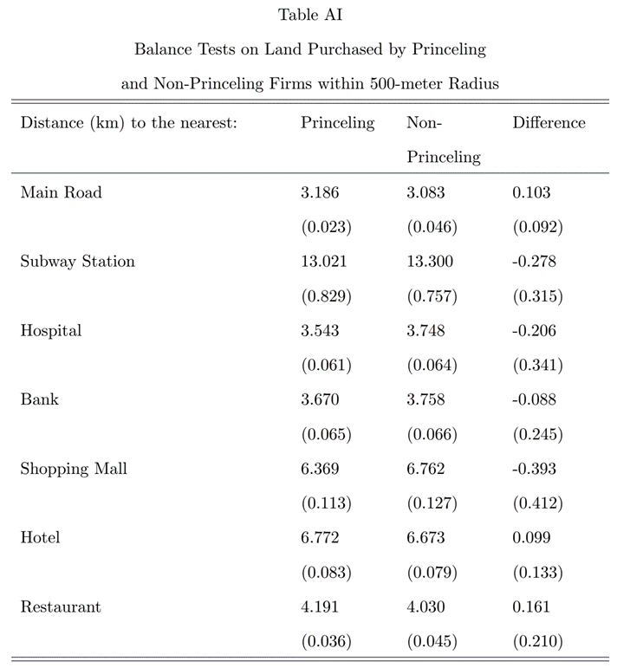
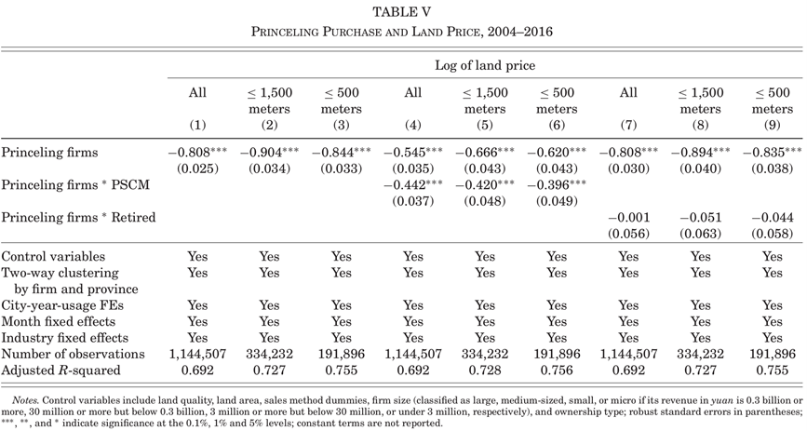
IV. Price Discount Obtained By Princeling Firms
Results
$${Price}_{ickst}=β_{0}+β_{1}{PrincelingPurchase}_{ikjt}+γX_{i}+T_{cst}+v_{ickst}.$$
Column (1)
Full sample
Significant at the 0.1%level
Selection bias
Turn to the matched samples within the two radii
An example
(land that is closer to the central business district or a mass transit railway station)
No significant differences

Slide 16
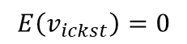
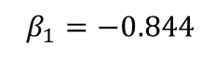
IV. Price Discount Obtained By Princeling Firms
Results
$${Price}_{ickst}=β_{0}+β_{1}{PrincelingPurchase}_{ikjt}+γX_{i}+T_{cst}+v_{ickst}.$$
57%
The price advantage for the Princeling firms compared with their Nonprinceling counterparts within the 500-meter radius
${PrincelingPurchase}_{ikjt}=1$——the Princeling firms
${PrincelingPurchase}_{ikjt}=0$——the Nonrinceling firms
Column (2) and Column (3)
More accurate estimates The price advantage for firms connected to the princelings(3)
57%
$$E\left(v_{ickst}\right)=0$$
The average log of land price of Princeling firms :
$E\left({Price}_{ickst}|X,{PrincelingPurchase}_{ikjt}=1\right)=β_{0}+β_{1}+γX_{i}+T_{cst}$(1)
The average log of land price of Nonprinceling firms :
$E\left({Price}_{ickst}|X,{PrincelingPurchase}_{ikjt}=0\right)=β_{0}+γX_{i}+T_{cst}$ (2)
We already know,
$$β_{1}=−0.844$$
$$Price discount =\frac{EXP\left(β_{0}+γX_{i}+T_{cst}\right)−EXP\left(β_{0}+β_{1}+γX_{i}+T_{cst}\right)}{EXP\left(β_{0}+γX_{i}+T_{cst}\right)}×100\%$$
$=\left[1−EXP\left(β_{1}\right)\right]×100\%=\left[1−EXP\left(−0.844\right)\right]×100\%=57\%$

Slide 17
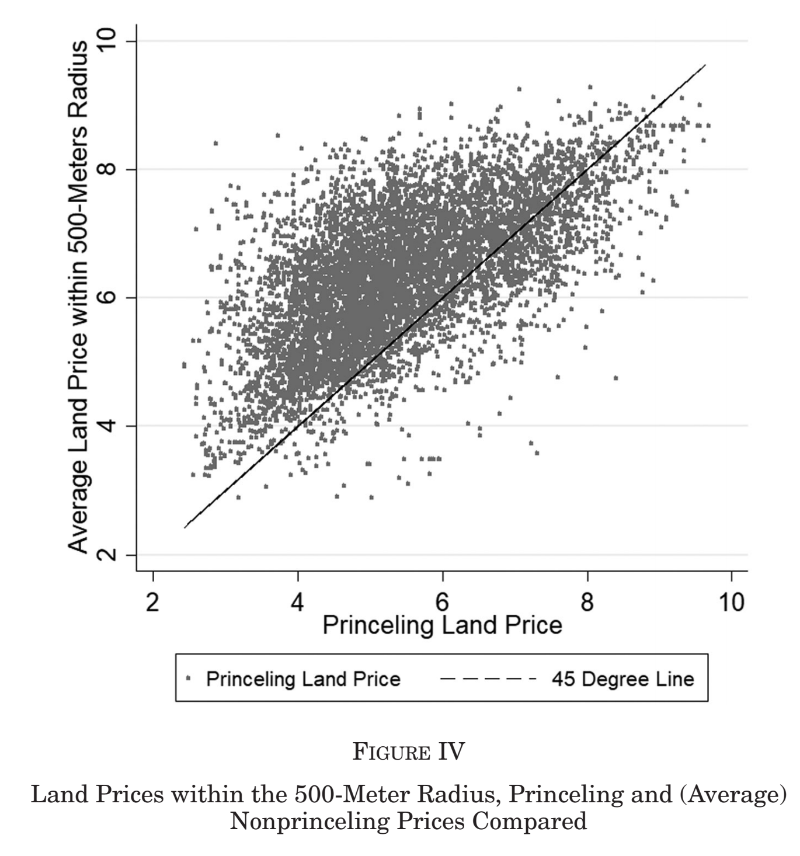
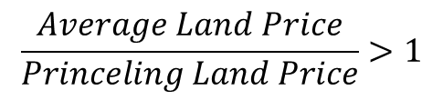
IV. Price Discount Obtained By Princeling Firms
To ensure not driven by a few outliers
$${Price}_{ickst}=β_{0}+β_{1}{PrincelingPurchase}_{ikjt}+γX_{i}+T_{cst}+v_{ickst}.$$
The 45-degree line
The princelings paid less
in the great majority of cases (80%)
$$\frac{Average Land Price}{Princeling Land Price}>1$$

Slide 18
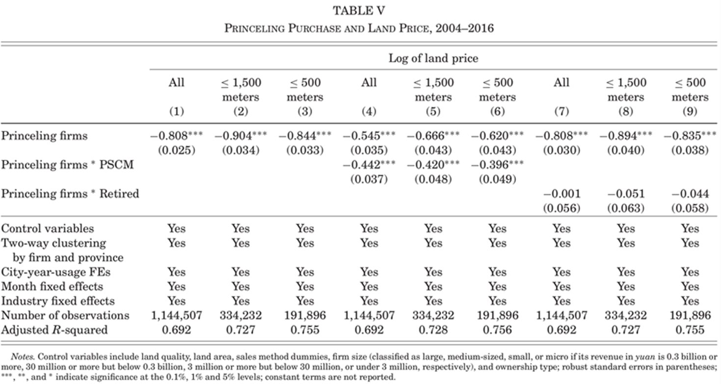
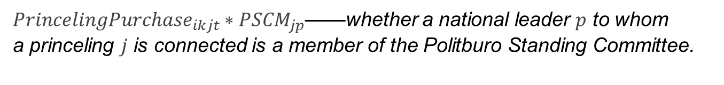
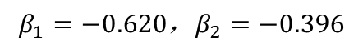
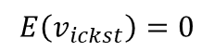
IV. Price Discount Obtained By Princeling Firms
Additional effects
17.6%
The increased price advantage for the Princeling firms connected to the Politburo Standing Committee compared with those connected to the ordinary Politburo members
Political power and status of the princelings
the Politburo Standing Committee > the ordinary members of the Politburo
Retirement of the princelings
Continue to exert influence over matters of personnel selection and appointment
$${Price}_{ickst}=β_{0}+β_{1}{PrincelingPurchase}_{ikjt}+β_{2}{PrincelingPurchase}_{ikjt}∗{PSCM}_{jp}+γX_{i}+T_{cst}+v_{ickst}$$
$$E\left(v_{ickst}\right)=0$$
Column (4) to Column (6)
On price is significantly larger Between 17.6% and 20.7%
Power and status indeed command a market price.
The average log of land price of Princeling firms connected to the Politburo Standing Committee :
Interacting
$$E\left({Price}_{ickst}|X,{PrincelingPurchase}_{ikjt}=1，{PSCM}_{jp}=1\right)=β_{0}+β_{1}+β_{2}+γX_{i}+T_{cst}$$
The average log of land price of Princeling firms connected to the ordinary Politburo members:
${PrincelingPurchase}_{ikjt}∗{PSCM}_{jp}$——whether a national leader $p$ to whom
a princeling $j$ is connected is a member of the Politburo Standing Committee.
$$E\left({Price}_{ickst}|X,{PrincelingPurchase}_{ikjt}=1，{PSCM}_{jp}=0\right)=β_{0}+β_{1}+γX_{i}+T_{cst}$$
The average log of land price of Nonprinceling firms :
$$E\left({Price}_{ickst}|X,{PrincelingPurchase}_{ikjt}=0，{PSCM}_{jp}=0\right)=β_{0}+γX_{i}+T_{cst}$$
${PrincelingPurchase}_{ikjt}∗{Retired}_{jpt}$——whether a particular transaction $i$ took place after leader$p$—the patron to whom the transaction was connected—retired.
We already know,
$$β_{1}=−0.620\text{，}β_{2}=−0.396$$
$$Increased Price discount=\frac{\left[EXP\left(β_{0}+γX_{i}+T_{cst}\right)−EXP\left(β_{0}+β_{1}+β_{2}+γX_{i}+T_{cst}\right)\right]−\left[EXP\left(β_{0}+γX_{i}+T_{cst}\right)−EXP\left(β_{0}+β_{1}+γX_{i}+T_{cst}\right)\right]}{EXP\left(β_{0}+γX_{i}+T_{cst}\right)}×100\%=\left[EXP\left(β_{1}\right)−EXP\left(β_{1}+β_{2}\right)\right]×100\%=\left[EXP\left(−0.620\right)−EXP\left(−0.620−0.396\right)\right]×100\%=17.6\%$$
Substituting,$β_{1}=−0.545$，$β_{2}=−0.442$ , 20.7% is obtained.

Slide 19
IV. Price Discount Obtained By Princeling Firms
Additional effects
Column (7) to Column (9)
The discount for the princeling firms does not diminish
after their patron’s retirement

Slide 20
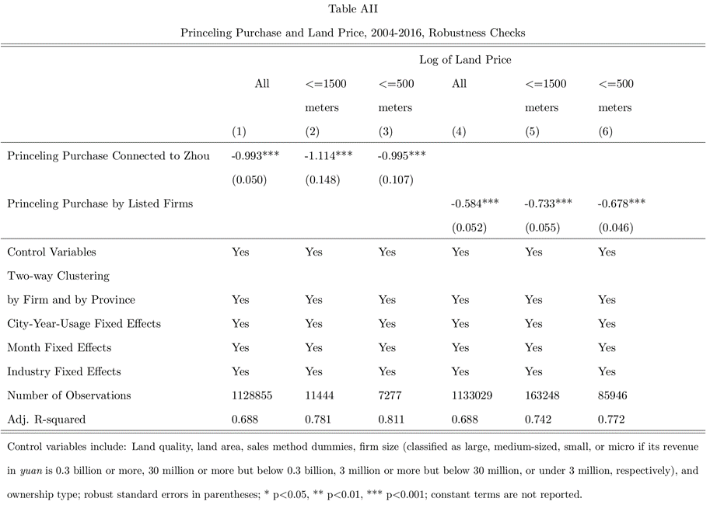
IV. Price Discount Obtained By Princeling Firms
Robustness Checks
Concern : Selection bias arising from selective , Inaccurate reporting
Two small but accurate subsamples
Zhou Yongkang and his son had connections with
various business entities.
Land purchases of the publicly listed firms
that are connected to the princelings in the
primary land market.
price discounts $≈$ baseline estimates

Slide 21
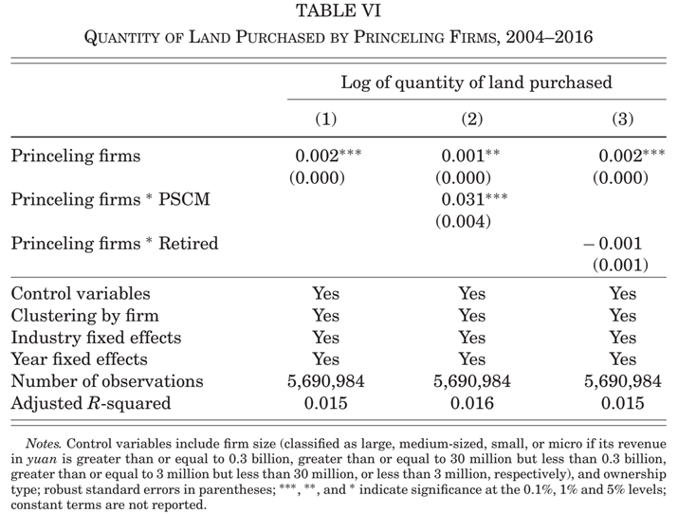
IV. Price Discount Obtained By Princeling Firms
A Larger Quantity of Land Purchases
Column (1)
0.2% more land
Column (2)
3% more land
Column (3)
No significant effect

Slide 22
II. Background
II.D. The Mainline of the Literature
How much the corrupt deals benefit each side？
The impact of President Xi’s anti-corruption campaign？
Main Conclusions of the Literature
Princeling Firms —— a price discount ( 55.4% ~ 59.9% )，More land purchases
Provincial Party Secretaries —— 23.4% more likely to be promoted
a reduction in corruption —— between 42.6% and 31.5% in the provinces
a reduction in the promotional prospects

Slide 23
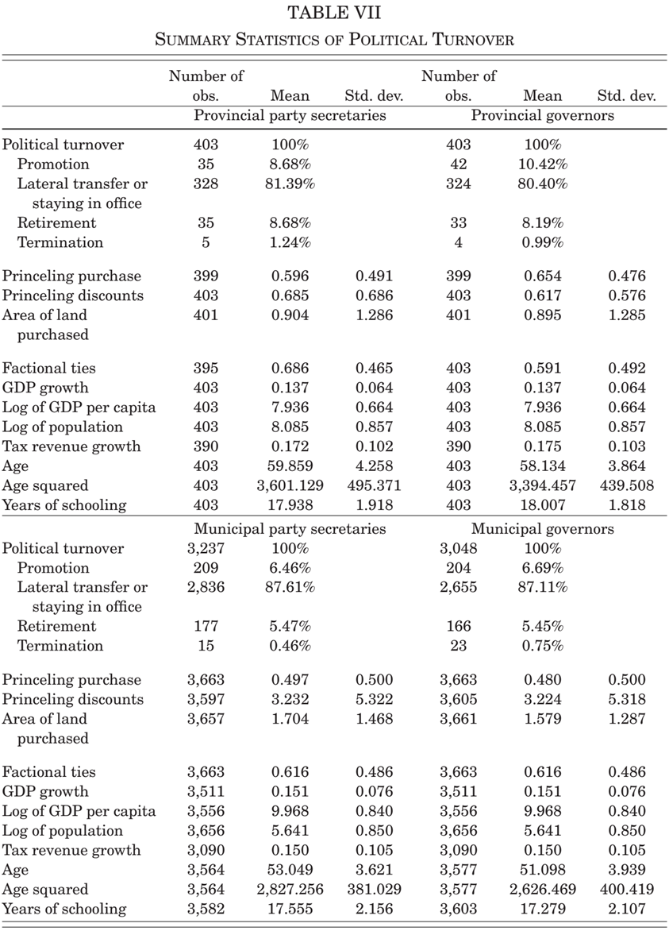
V. Effect of Business Favor on Prommotion
An Ordered Probit Model
province-year panel data from 2004 to 2016
Independent variable
$${Turnover}_{it}=∅_{0}+∅_{1}{PrincelingPurchase}_{it}+∅_{2}{FactionalTies}_{jt}+∅_{3}GDP{Growth}_{it}+κX_{it}+ωW_{j}+λ_{i}+T_{t}+φ_{j}+τ_{ijt}$$
$\text{D}\text{ependent} \text{variable} {Turnover}_{it}$—— the political turnover of the provincial officials measured on a yearly basis.
Whether a provincial official has ties with his or her patron in the Politburo.
Promotion = 3
Lateral transfer / staying in office = 2
Retirement = 1
Termination= 0
The individual characteristics of the provincial officials such as age, age squared, and years of education.
Economic performance using GDP or tax revenue growth rate as proxies.

Slide 24
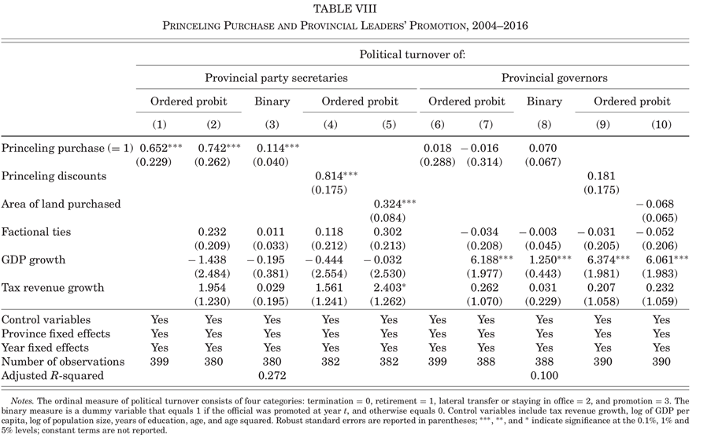
V. Effect of Business Favor on Prommotion
Column (1) and Column (6)
Only Princeling purchase Provincial party secretaries
has a significantly positive
effect on their promotion.
Provincial governors not.
Column (2) and Column (7)
Control for factional ties and GDP growth
Provincial party secretaries
remains highly significant.
Provincial governors not.
Column (3) and Column (8)
Replace with a binary measure (promotion , no promotion)
Similar conclusion

Slide 25
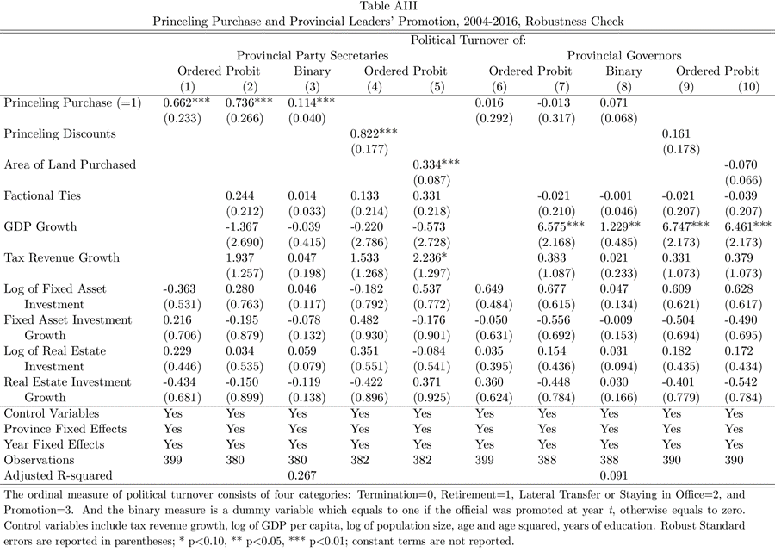
V. Effect of Business Favor on Prommotion
One Concern —— Alternative Hypothesis
Provinces provide discount
Provinces provide discount
The truth :
Princeling purchase remains significant,
with similar magnitudes
Reject!
Attract more investments
Attract more investments
Higher growth rates
Higher growth rates
Promotion
Promotion
Choose Proxies —— investment growth
e.g. size (level) and growth rates of fixed asset investments and real estate investments

Slide 26
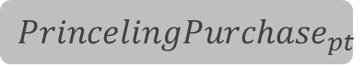
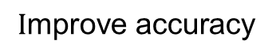
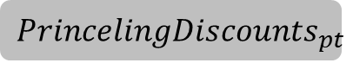
V. Effect of Business Favor on Prommotion
Another Concern —— too crude a measure
$${PrincelingPurchase}_{pt}$$
Lacks information on the steepness of the discount.
Column (4) and Column (9)
Princeling discounts Price discounts significantly increases the likelihood of
promotion for the provincial party secretary
Provincial governors not.
$${PrincelingDiscounts}_{pt}$$
$$\text{I}\text{mprove} \text{accuracy}$$
Match transactions
Price Discount
Aggregate to the prince level
Given year
Within the 500-meter radius
Princeling firms and Nonprinceling firms

Slide 27

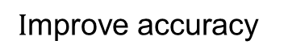
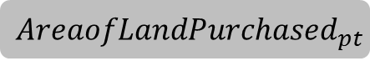
V. Effect of Business Favor on Prommotion
Another Concern —— too crude a measure
Column (5) and Column (10)
Area of land purchased A significant effect on the
party secretary’s promotion.
Provincial governors not.
Governor has to rely on himself for promotion ( improving economic performance or GDP growth in his jurisdiction )
Only the provincial party secretaries are being rewarded for their wheeling and dealing.
$${PrincelingPurchase}_{pt}$$
Lacks information on the steepness of the discount.
$${AreaofLandPurchased}_{pt}$$
$$\text{I}\text{mprove} \text{accuracy}$$
The total area of land sold to the princeling firms
Given year
Given province

Slide 28
V. Effect of Business Favor on Prommotion
Turn to the municipal officials
Expected to be rewarded
Patron–Client Network
Direct clients (直接委托人)
Provincial officials
Princeling firms
Patrons(雇主)
Municipal officials
Custodians of land in the primary market(土地保管人)

Slide 29
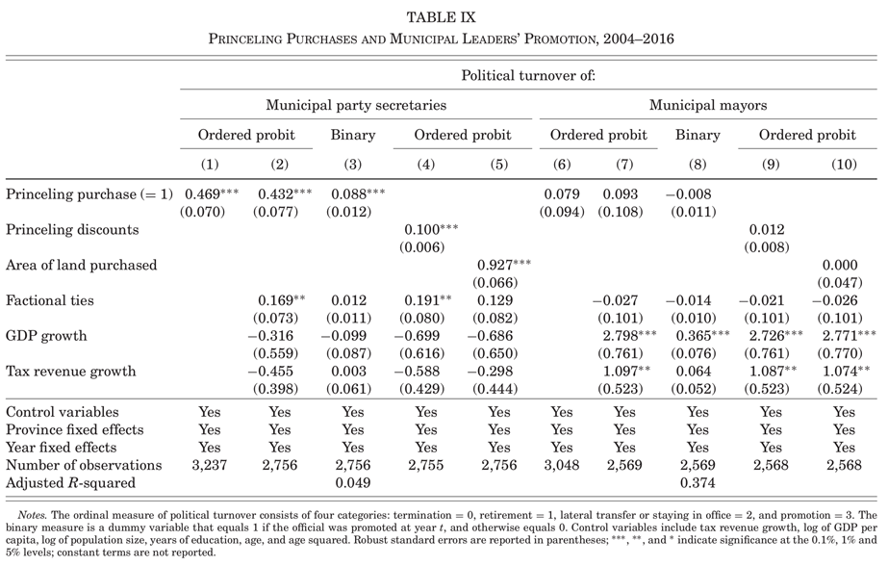
V. Effect of Business Favor on Prommotion
Turn to the municipal officials —— the same meature
Consistent with the provincial results.

Slide 30
VI. Effect of Xi’s Anticorruption Campaign
“transactions after 2012”
Examining the effect of Xi’s anticorruption campaign(2012.12.04)
Constructing 3 separate measures
“central inspection”
“Xi-appointed officials”

Slide 31
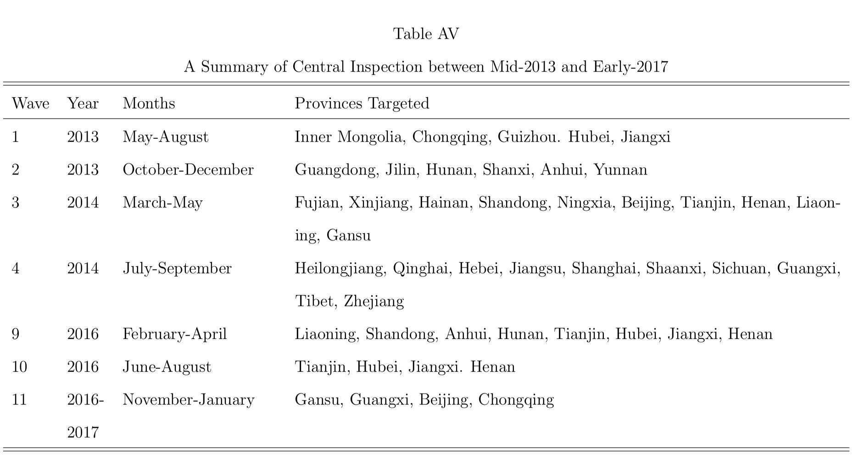
VI. Effect of Xi’s Anticorruption Campaign
“transactions after 2012”
All 31 provinces and directly controlled municipalities have been inspected, 16 of them twice.

Slide 32
VI. Effect of Xi’s Anticorruption Campaign
“Xi-appointed officials”
Xi replaced a total of 14 provincial party secretaries between 2013 and 2016.
More likely to enforce the anticorruption campaign
Price discounts would become smaller and reciprocal promotions less frequent after 2012.

Slide 33
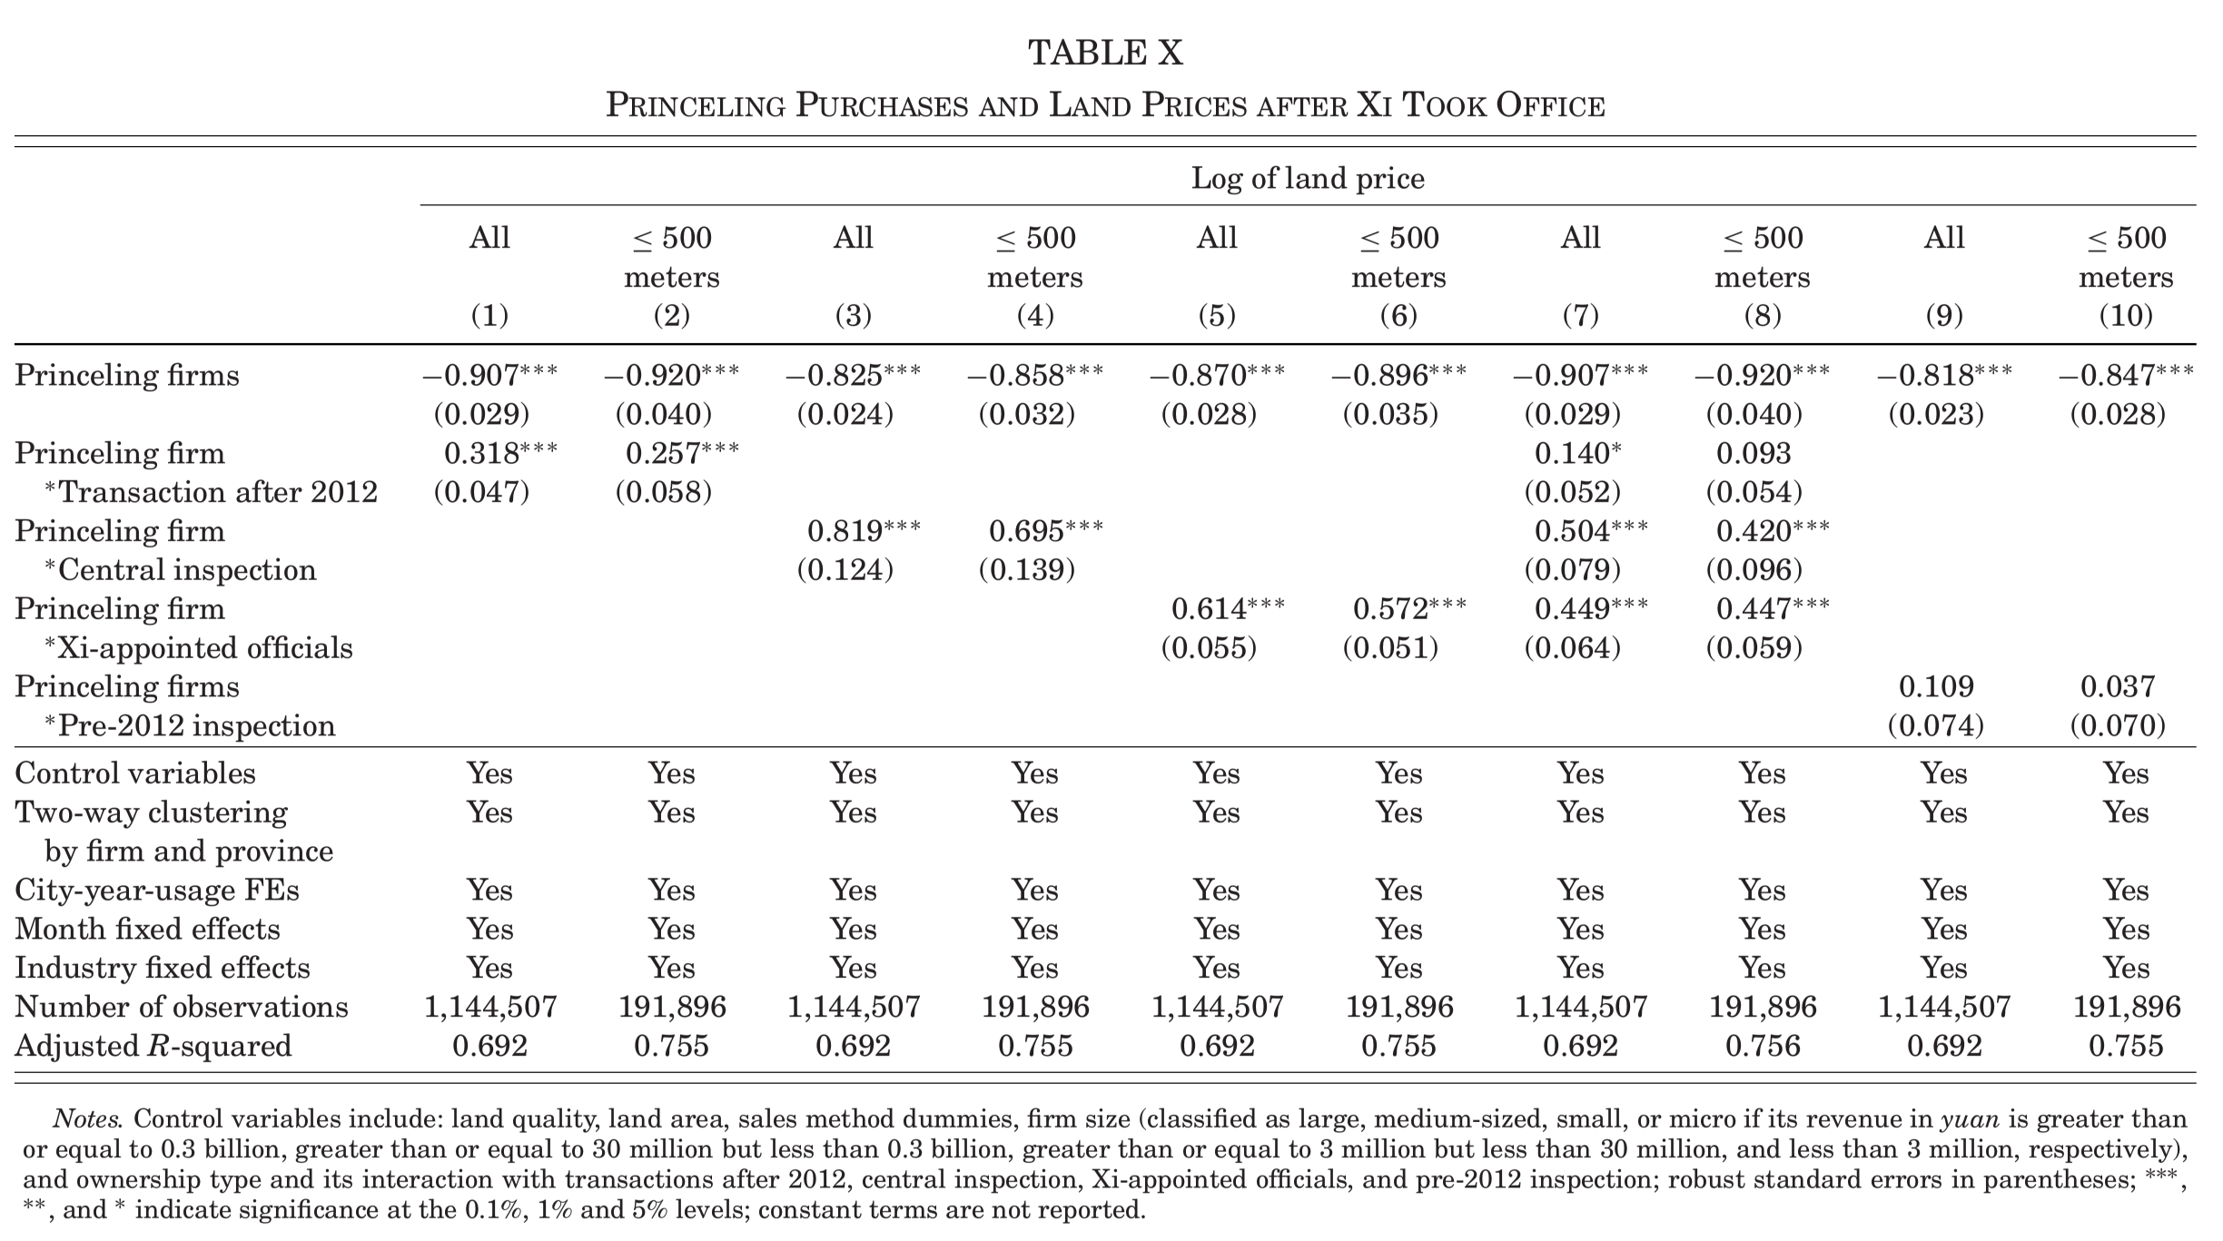

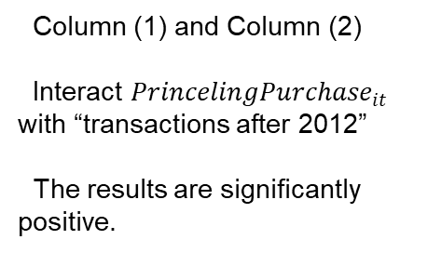
VI. Effect of Xi’s Anticorruption Campaign
VI.A. Land Prices —— Results
Column (1) and Column (2)
Interact ${PrincelingPurchase}_{it}$ with “transactions after 2012” The results are significantly positive.
e.g. After Xi’s campaign, price
discount reduced by 11.7%.
exp(−0.92) −exp(−0.92 + 0.257)
=−0.117

Slide 34
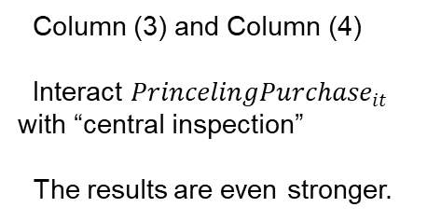
VI. Effect of Xi’s Anticorruption Campaign
VI.A. Land Prices —— Results
Column (3) and Column (4)
Interact ${PrincelingPurchase}_{it}$ with “central inspection” The results are even stronger.
e.g. After central inspection, price discount reduced by 42.6%.
exp(−0.858+0.695) −
exp(-0.858)=0.426

Slide 35
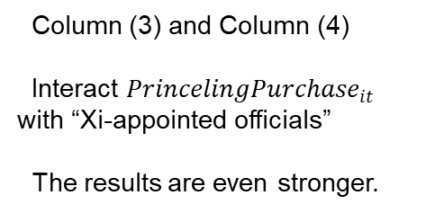
VI. Effect of Xi’s Anticorruption Campaign
VI.A. Land Prices —— Results
Column (3) and Column (4)
Interact ${PrincelingPurchase}_{it}$ with “Xi-appointed officials” The results are even stronger.
e.g. After Xi-appointed officials, price discount reduced by 31.5%.
exp(−0.896+0.572) −
exp(-0.896)=0.315
Which of these measures are more effective? “central inspection” and “Xi-appointed officials”.

Slide 36
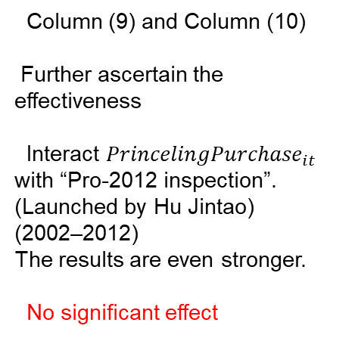
VI. Effect of Xi’s Anticorruption Campaign
VI.A. Land Prices —— Results
Column (9) and Column (10)
Further ascertain the effectiveness
Interact ${PrincelingPurchase}_{it}$ with “Pro-2012 inspection”.
(Launched by Hu Jintao)
(2002–2012) The results are even stronger.
No significant effect

Slide 37
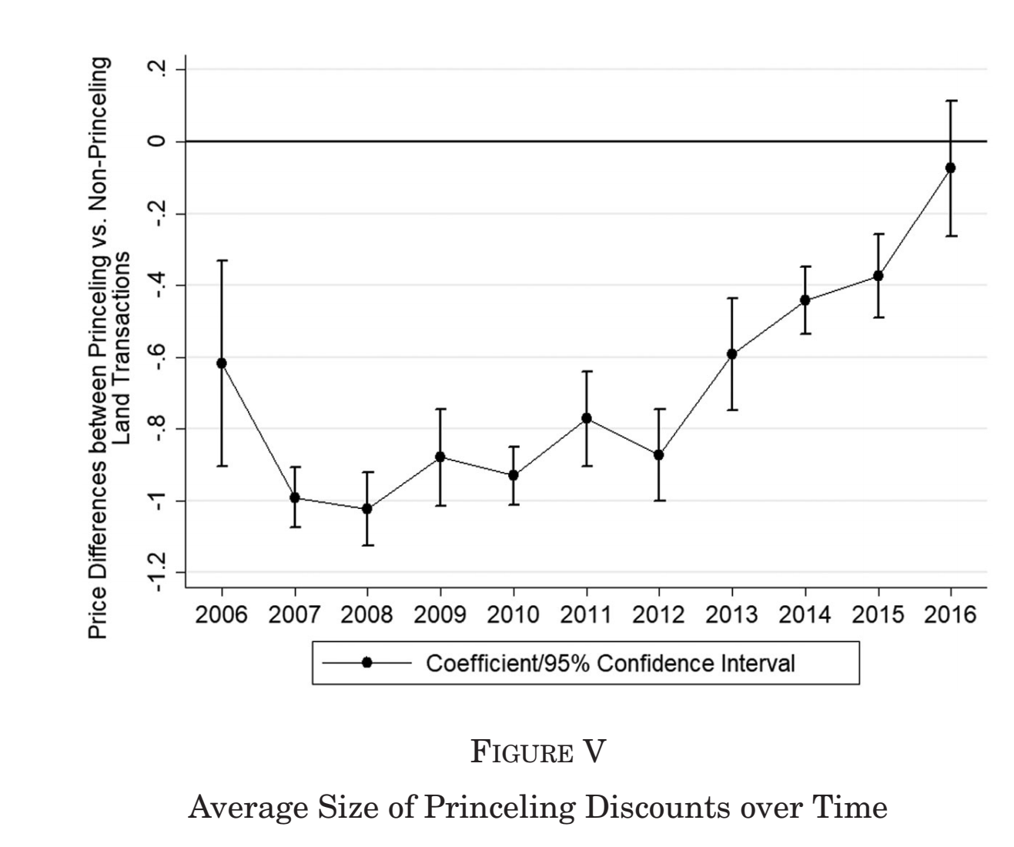
VI. Effect of Xi’s Anticorruption Campaign
VI.A. Land Prices —— in a broader perspective
Interact coefficients estimated on princeling purchase with a series of year dummies.
SHOW : The average size of the discounts obtained by the Princeling firms (2006 to 2016).

Slide 38

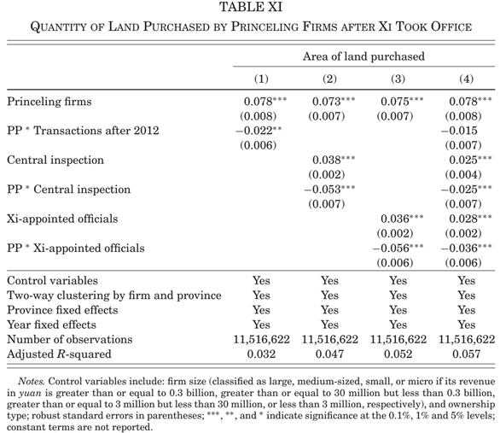
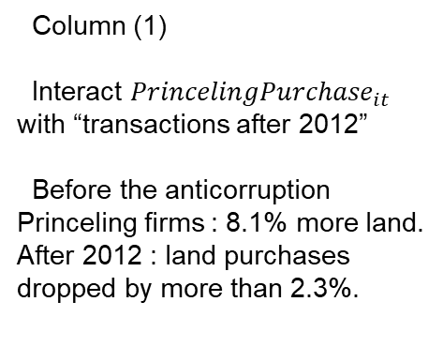
VI. Effect of Xi’s Anticorruption Campaign
VI.B. Quantity of Land Sold to the Princeling Firms
Column (1)
Interact ${PrincelingPurchase}_{it}$ with “transactions after 2012” Before the anticorruption
Princeling firms : 8.1% more land.
After 2012 : land purchases dropped by more than 2.3%.
38

Slide 39
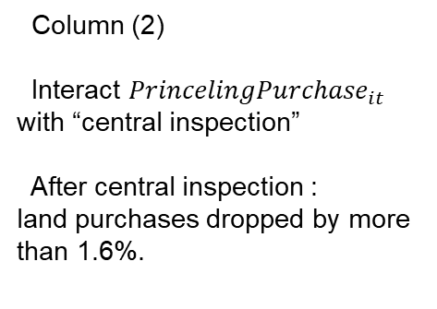
VI. Effect of Xi’s Anticorruption Campaign
VI.B. Quantity of Land Sold to the Princeling Firms
Column (2)
Interact ${PrincelingPurchase}_{it}$ with “central inspection” After central inspection :
land purchases dropped by more than 1.6%.
39

Slide 40
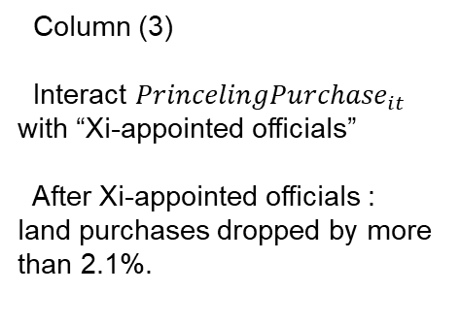
VI. Effect of Xi’s Anticorruption Campaign
VI.B. Quantity of Land Sold to the Princeling Firms
Column (3)
Interact ${PrincelingPurchase}_{it}$ with “Xi-appointed officials” After Xi-appointed officials :
land purchases dropped by more than 2.1%.
40

Slide 41
VI. Effect of Xi’s Anticorruption Campaign
VI.B. Quantity of Land Sold to the Princeling Firms
These results are consistent with those on the price discounts.
41
Which of these measures are more effective? “central inspection” and “Xi-appointed officials”.

Slide 42
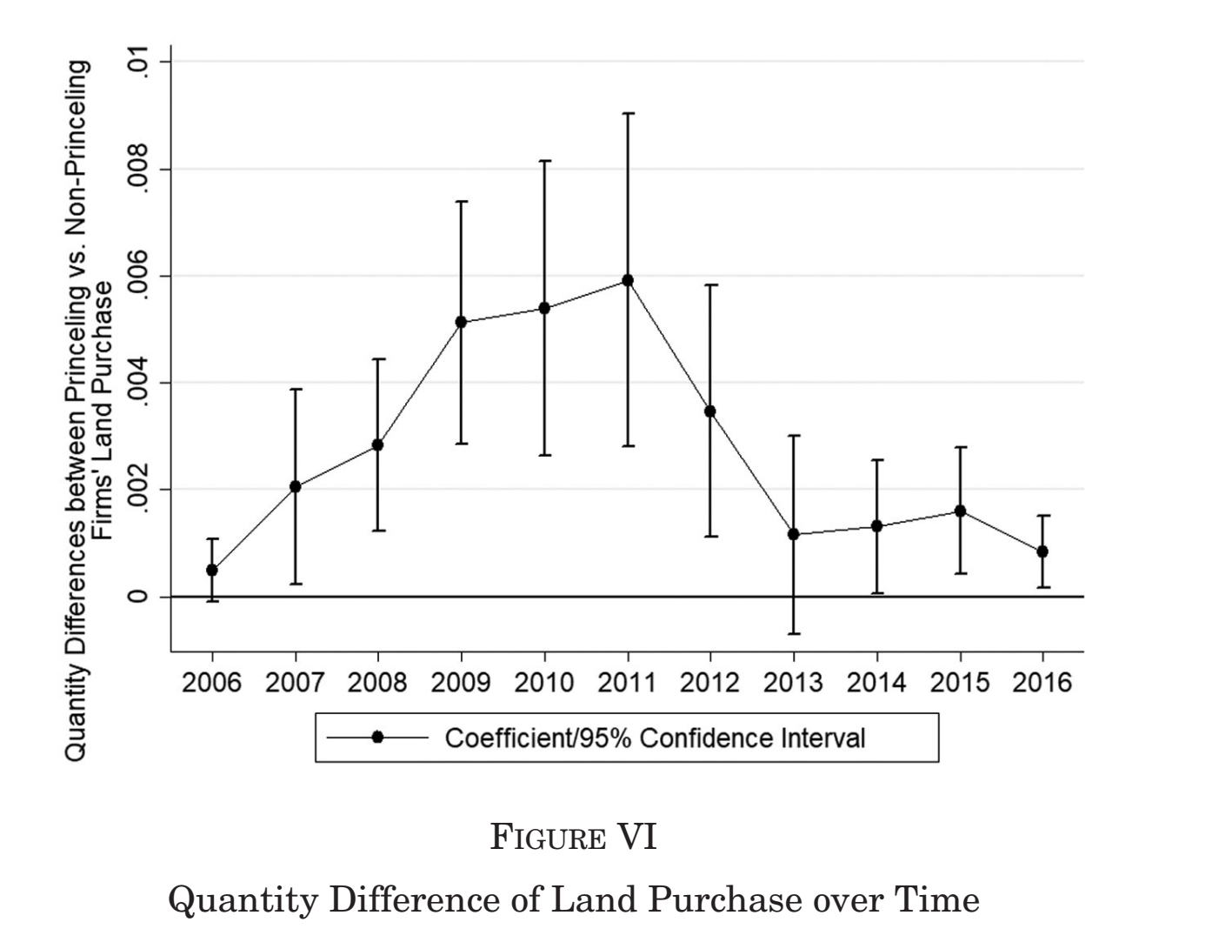
VI. Effect of Xi’s Anticorruption Campaign
VI.B. Quantity of Land Sold to the Princeling Firms —— in a broader perspective
Interact coefficients estimated on princeling purchase with a series of year dummies.
SHOW : The average quantity of land sold difference obtained by the Princeling firms (2006 to 2016).

Slide 43
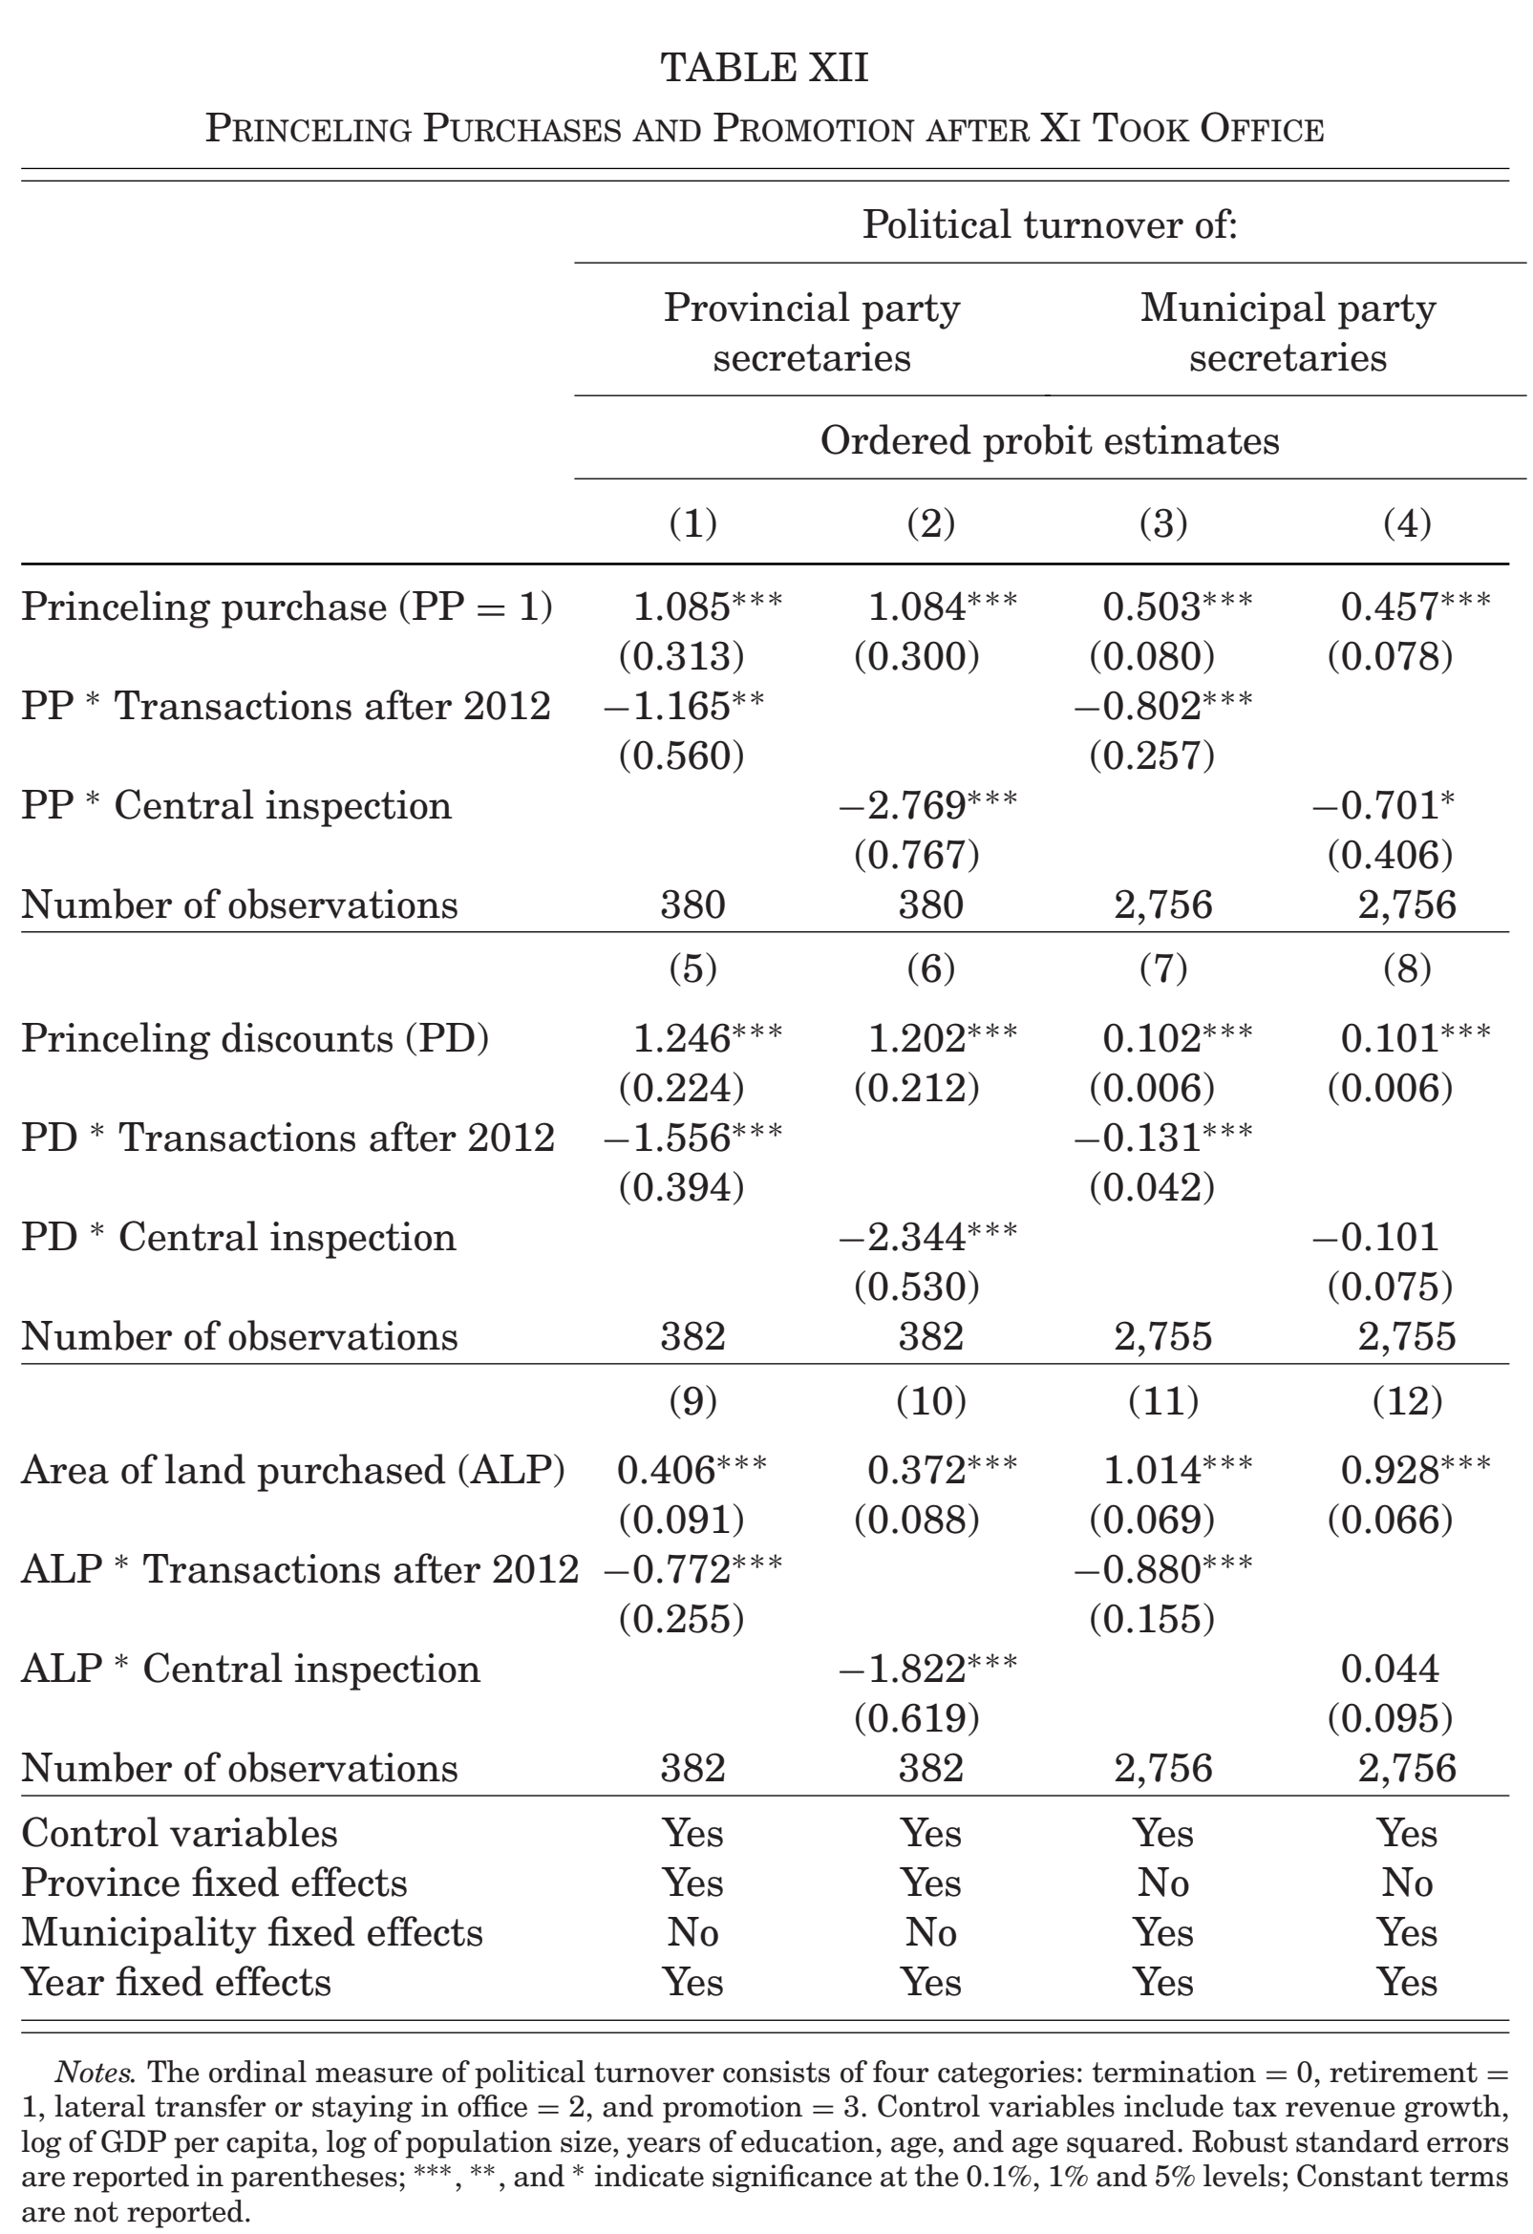
VI. Effect of Xi’s Anticorruption Campaign
VI.C. Political Turnover
Xi’s anticorruption efforts
Promotional prospects of local officials
SHOW : After 2012，in provinces audited by the central inspection
Team，Princeling purchase (or PD,ALP)on the promotion of party
secretaries was significantly reduced.
CONCLUSION ：Xi’s campaign to crack down on corruption has also reduced the promotional prospects of local officials who rely on supplying a discount to get ahead.
39

Slide 44
VI. Effect of Xi’s Anticorruption Campaign
VI.D. An Event Study of Zhou Yongkang
Further confirm the effectiveness of Xi’s anticorruption campaign
Hypothesis :
2013.12.01，Zhou Yongkang and his son were arrested
one day after news broke
the local officials stopped providing favors to the princeling firms (connected on the news of Zhou’s arrest)
Test :Comparing the price and quantity of land transactions conducted by princeling and nonprinceling firms in the primary land market after 2013.12.01.
44

Slide 45
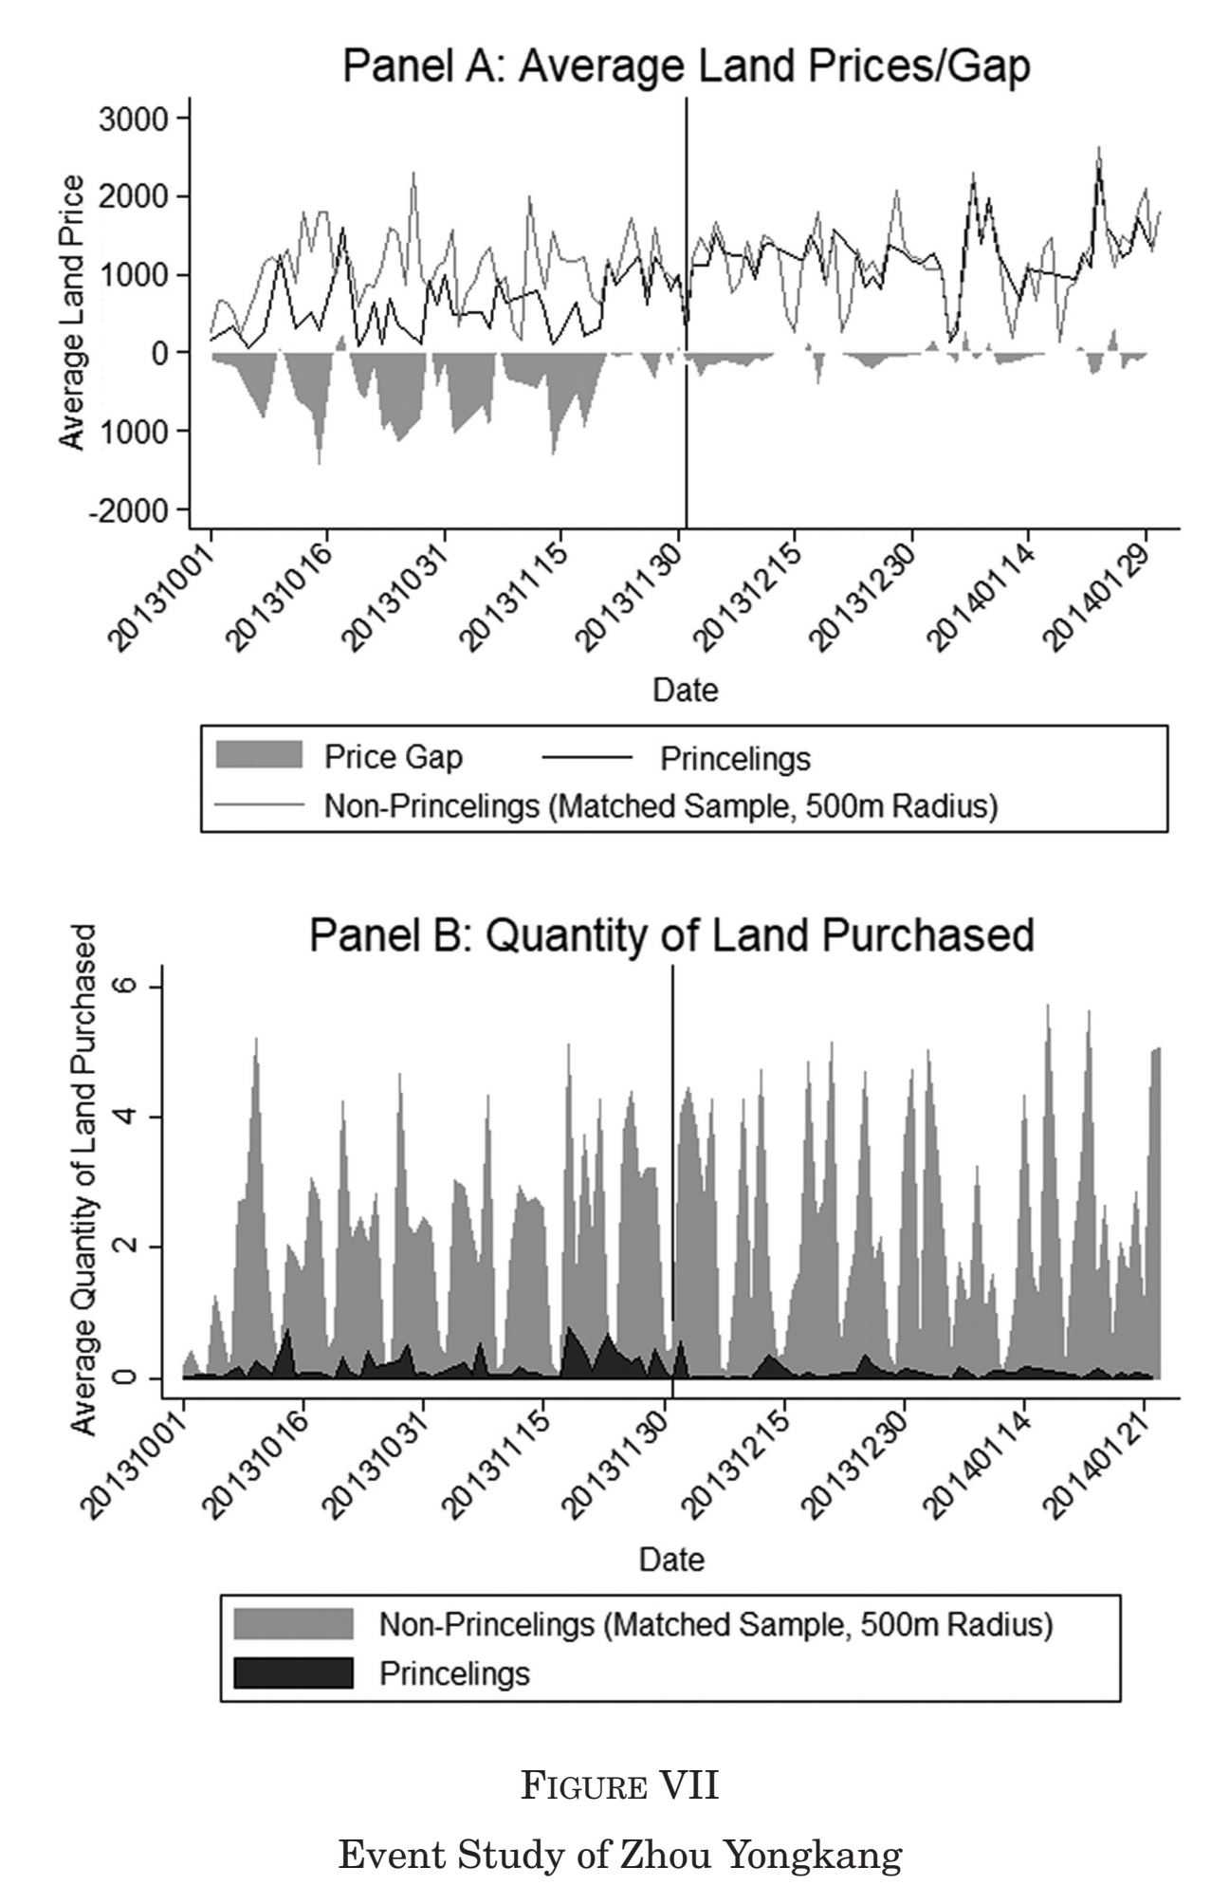
VI. Effect of Xi’s Anticorruption Campaign
VI.D. An Event Study of Zhou Yongkang
45

Slide 46
VII. CONCLUSION
Main Conclusions of the Literature
Princeling Firms —— a price discount ( 55.4% ~ 59.9% )，More land purchases
Provincial Party Secretaries —— 23.4% more likely to be promoted
By Xi’s anticorruption campaign —— strengthening the CCDI and appointing his own trusted subordinates to govern in as many as 14 provinces.
a reduction in corruption —— between 42.6% and 31.5% in the provinces
a reduction in the promotional prospects
Although the anticorruption campaign has thus far produced positive results, whether corruption can be fundamentally weeded out without overhauling the existing institutional arrangements causing them remains an issue of fundamental importance, one that deserves investigation in the near future!
46

Slide 47

THANKS FOR WATCHING
The literature can be downloaded from https://doi.org/10.1093/qje/qjy027.

